Slide 1
Understanding Behavior Plans
UNDERSTANDING
CONSEQUENCES
IN ABA
Reinforcement, Punishment &
Behavior Change for Parents

Slide 2
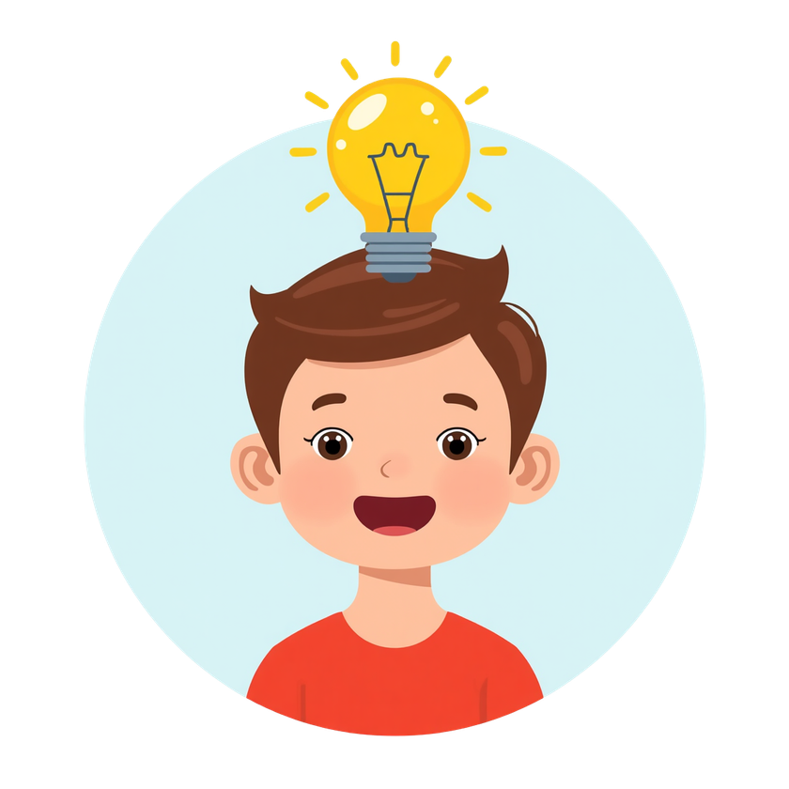
WHAT IS A CONSEQUENCE?
A consequence is anything that happens immediately after a behavior. Consequences teach children what behaviors work for them!
Toddler examples:
• Crying → gets candy
• Signing "more" → gets bubbles
• Throwing spoon → parent laughs
• Biting → cleanup stops
Remember: Consequences aren't "good" or "bad" - they simply influence whether behaviors happen again!

Slide 3
REINFORCEMENT VS PUNISHMENT
Reinforcement: Any consequence that increases future behavior.
Punishment: Any consequence that decreases future behavior.
Remember: These terms describe the effect on behavior, not whether something feels good or bad!
Surprising truth: Something unpleasant can actually reinforce behavior, and an intended punishment may not decrease behavior at all.

Slide 4

FOUR MAIN TYPES OF CONSEQUENCES
• Positive Reinforcement: Something added → behavior increases (praise after sharing)
• Negative Reinforcement: Something removed → behavior increases (noise stops after covering ears)
• Positive Punishment: Something added → behavior decreases ("no" after hitting)
• Negative Punishment: Something removed → behavior decreases (toy taken after throwing)

Slide 5

POSITIVE REINFORCEMENT
Something is added after a behavior, and the behavior increases!
Examples:
  Your toddler says "juice" → gets juice.
  Cleaning up blocks → earns praise and high-five.
  Sitting nicely at the table → gets favorite snack.
  Using gentle hands → gets fun tickles!
You post a picture on social media and receive lots of likes and positive comments. Because attention and praise were added after the behavior, you are more likely to post again in the future.

Slide 6
POSITIVE REINFORCEMENT
  Choosing an activity
  Choosing a toy
  Special helper jobs
  Breaks paired with praise
  Small prizes
  Outdoor play
  Water play
  Dance parties
  Favorite videos
  Pretend play
  Reading favorite books
  Social praise from peers
  Access to playground equipment
  Earning points or rewards
  Positive notes home
  Earning privileges
  Preferred seating
  Special one-on-one time
  Reinforcement menus or choice boards
Common examples of positive reinforcement used in ABA include:
  Verbal praise (“Great job!”)
  High-fives
  Clapping and cheering
  Stickers
  Tokens or token boards
  Bubbles
  Favorite snacks
  Access to preferred toys
  Tablet or screen time
  Music or songs
  Tickles
  Hugs or cuddles
  Attention from adults
  Playing a favorite game
  Extra playtime
  Swing time
  Sensory activities

Slide 7
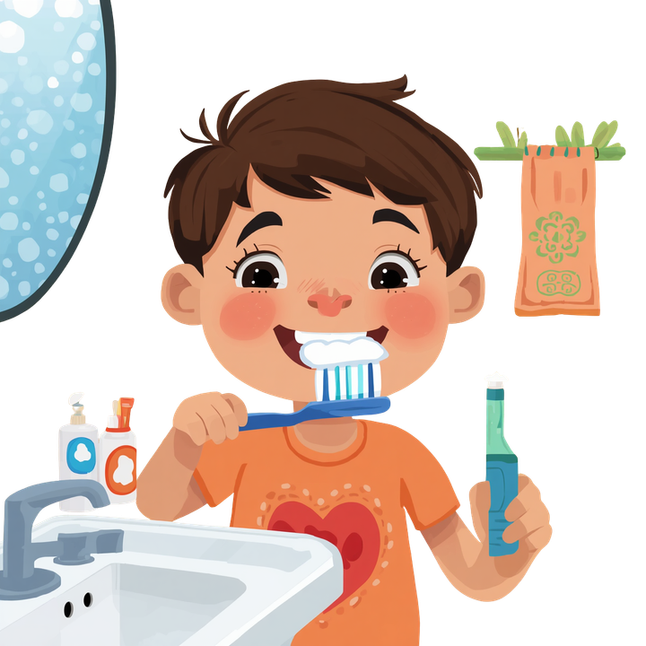
POSITIVE REINFORCEMENT PRACTICE
Scenario: Sophia brushes her teeth all by herself. Dad says "Great job brushing!" and gives her a high-five. Now Sophia brushes independently more often!
Can you identify:
• What was the behavior?
• What was the consequence?
• Was something added or removed?
• Did the behavior increase or decrease?

Slide 8
NEGATIVE REINFORCEMENT
Something is removed after a behavior, and the behavior increases! This is NOT punishment.
Examples:
  Buckling your seatbelt to stop the beeping sound
  Taking pain medicine to get rid of a headache
  Child asks for a break and homework stops briefly
  Putting on sunglasses to reduce bright light
  Cleaning your room so parents stop reminding you
Your car starts beeping because your seatbelt is not on. You buckle your seatbelt, and the beeping stops. Because the annoying sound was removed, you are more likely to buckle your seatbelt quickly in the future.
The behavior worked to remove something uncomfortable!

Slide 9
Examples Used in ABA:
  Child asks for a break → work pauses
  Toddler signs “all done” → food removed
  Child says “help” → task becomes easier
  Student wears headphones → noise reduced
  Child finishes chores → reminders stop
  Toddler requests break → table work pauses
  Child says “stop” → tickles stop
  Student completes work → extra work avoided
  Child asks to leave noisy room → noise removed
  Child puts on headphones → loud noise reduced
  Lights are dimmed → bright light discomfort decreases
  Child moves to quiet corner → noise decreases
  Toddler covers with blanket → cold feeling reduced
  Child wears sunglasses → bright sunlight reduced
  Student uses fidget → uncomfortable sensory feelings decrease
  Child requests weighted blanket → body feels calmer
  Toddler leaves crowded room → sensory overload reduced
  Child turns down music → sound decreases
  Student uses chewy tube → oral sensory discomfort reduced
NEGATIVE REINFORCEMENT

Slide 10
NEGATIVE REINFORCEMENT
Three-year-old Lucas is working on a matching activity at the table and begins looking frustrated. Instead of crying, Lucas hands his “break” card to his therapist. The therapist immediately gives Lucas a short break from the activity. Over time, Lucas begins using the break card more often during difficult tasks.
Discussion Questions
  What behavior did Lucas use?
  What was removed after the behavior?
  Did the behavior increase or decrease?
  Why is this an example of negative reinforcement?

Slide 11
POSITIVE PUNISHMENT
Something is added after a behavior, and the behavior decreases.
Formula: Behavior → Something Added → Behavior Decreases.
Examples:
Throwing food → parent says "No"
Hitting peer → adult blocks and corrects.
You are driving over the speed limit and receive a speeding ticket. Because something was added after the behavior (the ticket), you may be less likely to speed in the future.
You touch a hot pan on the stove and immediately feel pain. The pain was added after the behavior, so you are less likely to touch the hot pan again.

Slide 12
POSITIVE PUNISHMENT
Examples Used in ABA
  Child hits peer → adult gives verbal correction
  Toddler throws food → parent says “Food stays on the table”
  Child climbs on furniture → adult redirects child off furniture
  Student shouts out → teacher gives reminder to raise hand
  Child bites → adult blocks and redirects behavior
  Toddler throws toys → instructed to help clean up
  Child runs away → adult immediately guides child back
  Student scribbles on wall → required to help clean it
  Child grabs toys → adult says “Ask first” and prompts requesting
  Toddler splashes water excessively → adult provides correction and stops behavior

Slide 13
POSITIVE PUNISHMENT
Scenario: Positive Punishment
Two-year-old Ava repeatedly throws food off her tray during lunch. Each time she throws food, her parent immediately says, “Food stays on the table,” and has Ava help pick up the food. Over time, the food throwing begins to decrease.
Discussion Questions
  What was the behavior?
  What consequence occurred after the behavior?
  Was something added or removed?
  Did the behavior increase or decrease?
  Why is this an example of positive punishment?

Slide 14
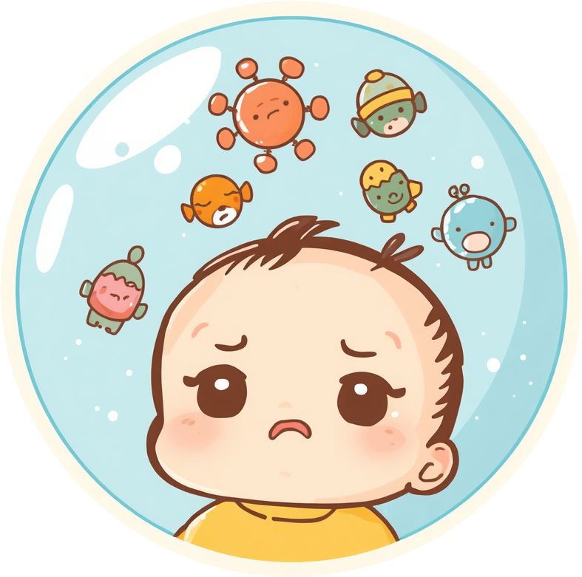
NEGATIVE PUNISHMENT
Something is removed after a behavior, and the behavior decreases.
Examples:
Taking away a toy after throwing it
Putting bubbles away after hitting
Removing a climbing toy temporarily
Remember: "Negative" means removed, not harsh! Always pair with teaching replacement skills.
A child throws toys during playtime, and the toys are put away for a short period of time. Because access to the toys was removed after the behavior, toy throwing may decrease in the future.
You repeatedly forget to pay a credit card bill, and the company removes promotional rewards or cashback benefits. Because something valuable was removed after the behavior, you may become more likely to pay on time in the future.

Slide 15
NEGATIVE PUNISHMENT
Examples Used in ABA:
  Child throws toy → toy removed briefly
  Toddler hits during play → bubbles put away
  Child screams for tablet → tablet unavailable temporarily
  Student misuses markers → markers removed
  Child throws food → plate removed for short period
  Toddler climbs unsafely → access to climbing toy removed
  Child hits sibling → loss of preferred activity briefly
  Student breaks classroom rules → loses token or point
  Child throws blocks → blocks removed temporarily
  Toddler bites during play → play activity paused briefly

Slide 16
NEGATIVE PUNISHMENT
Three-year-old Mason begins throwing blocks at his sister during playtime. His parent calmly removes the blocks and says, “Blocks are all done when we throw them.” After several consistent responses, Mason begins throwing blocks less often.
Discussion Questions
  What was the behavior?
  What consequence occurred after the behavior?
  Was something added or removed?
  Did the behavior increase or decrease?
  Why is this an example of negative punishment?

Slide 17
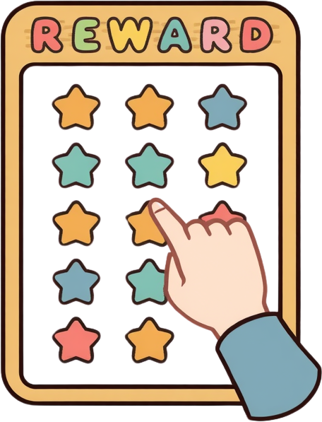
RESPONSE COST
Response cost means removing a specific reinforcer when an unwanted behavior happens. Examples include losing a token on a reward chart or losing screen time.
Tips: explain the rule clearly beforehand, apply it consistently every time, never remove ALL reinforcement, and always pair with praise for good behavior!
13

Slide 18
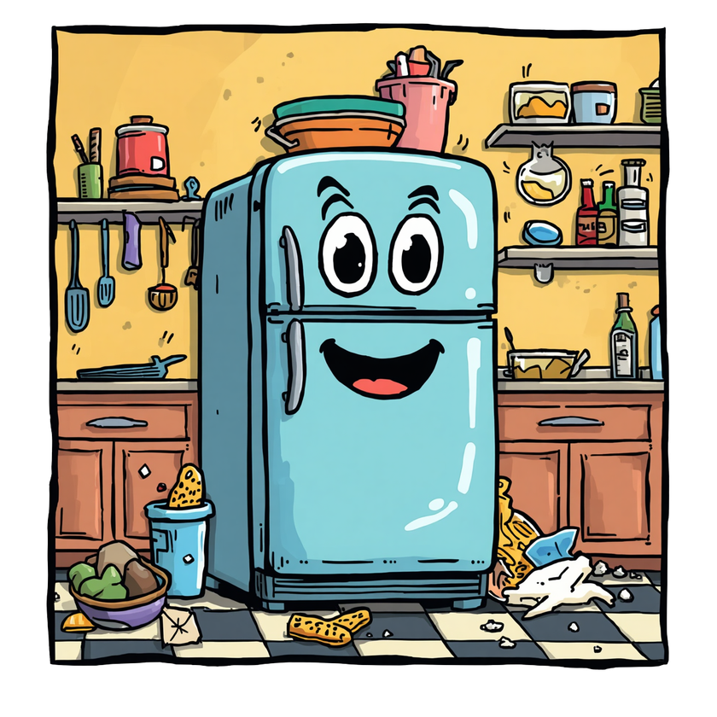
USING CONSEQUENCES BASED ON THE GOAL OF THE BEHAVIOR
NOT ALL BEHAVIORS ARE TREATED THE SAME
In ABA, we first try to understand:
Why the behavior is happening (the function)
Whether it is a behavior we want to increase or decrease
Then we choose consequences based on the goal.
Two-year-old Mia points to the refrigerator and says “juice.” Her dad immediately gives her juice and says, “Nice asking!”
  Do we want this behavior to increase or decrease?
  What consequence occurred?
  Was something added or removed?
  What type of consequence is this?

Slide 19
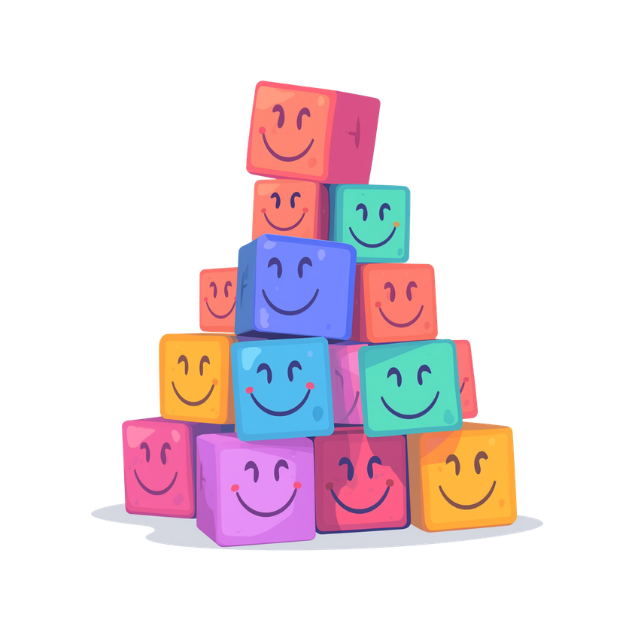
USING CONSEQUENCES BASED ON THE GOAL OF THE BEHAVIOR
NOT ALL BEHAVIORS ARE TREATED THE SAME
Sophia screams for her tablet during dinner. Her parents do not give the tablet after screaming, but later provide it when she calmly requests it.
  Which behavior are the parents trying to increase?
  Which behavior are they trying to decrease?
  What consequence strategy is being used?
  Why might this help over time?
During cleanup time, Noah throws blocks across the room. His mom removes the blocks for a few minutes and redirects him to another activity.
  Do we want this behavior to increase or decrease?
  What consequence occurred?
  Was something added or removed?
  What type of consequence is this?

Slide 20

USING CONSEQUENCES BASED ON THE GOAL OF THE BEHAVIOR
NOT ALL BEHAVIORS ARE TREATED THE SAME
Emma begins whining during a difficult puzzle. Instead of whining, she signs “help.” Her therapist immediately helps her finish part of the puzzle.
  Do we want this behavior to increase or decrease?
  What consequence occurred?
  Was something added or removed?
  What type of consequence is this?
Liam repeatedly climbs on the kitchen table. His parent immediately says, “Feet on the floor,” and helps him off the table each time.
  Do we want this behavior to increase or decrease?
  What consequence occurred?
  Was something added or removed?
  What type of consequence is this?

Slide 21
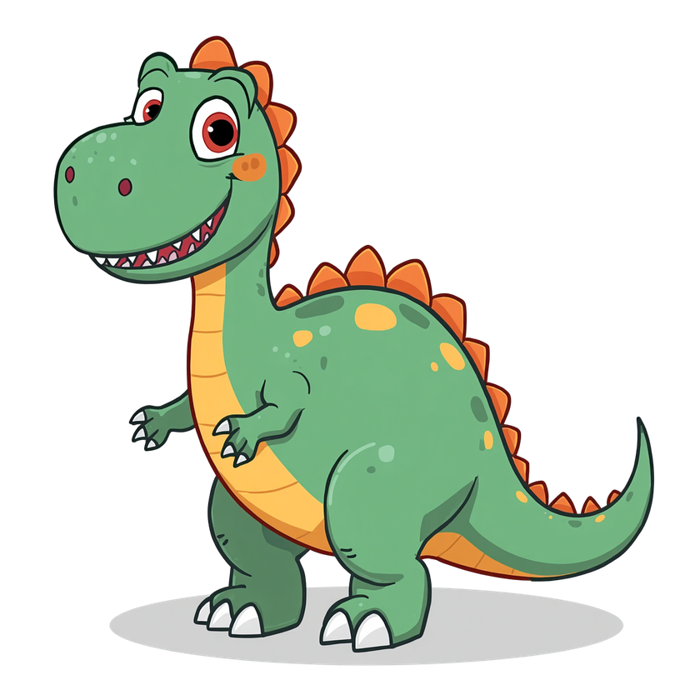
EXTINCTION
Extinction means a behavior no longer produces the payoff it used to get. When a behavior stops getting reinforcement, it gradually decreases over time.
Examples: Screaming for candy no longer works when parents stay calm and don't give in. Throwing a spoon no longer gets laughs.
Key points: Consistency is critical for extinction to work. Always pair extinction with teaching replacement skills!

Slide 22

EXTINCTION BURST
When you stop reinforcing a behavior, it may temporarily get worse before it gets better! This is called an extinction burst.
Example: If you stop giving attention for whining, your toddler may whine louder or longer at first. This is normal and shows the strategy is working, stay consistent!
Imagine you normally text your spouse while they are at work, and they usually respond quickly. One day, they suddenly stop replying. At first, you might text more often, send longer messages, call them, or become frustrated before eventually stopping.
6

Slide 23
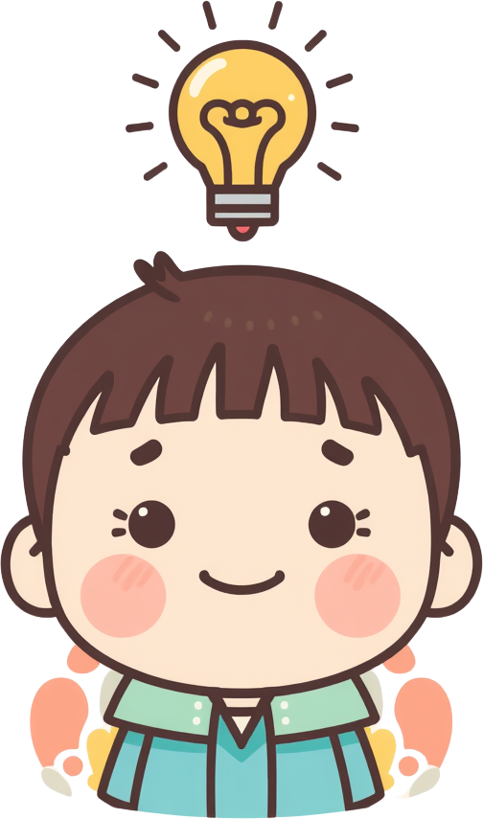
WHAT WE LEARNED TODAY
• Consequences shape future behavior
• Reinforcement increases behavior
• Punishment decreases behavior
• Positive = something added
• Negative = something removed
• Consistency and calm responses help learning
• Always teach communication and replacement skills

Slide 24
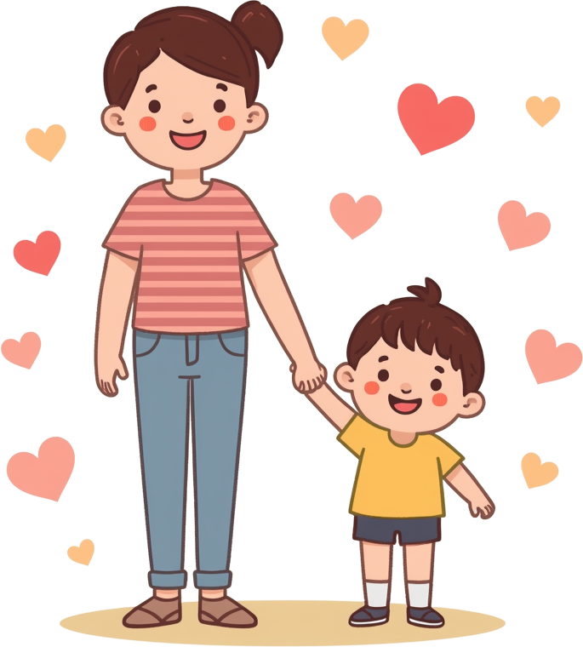
MOST IMPORTANT REMINDER
Children succeed when adults stay calm and consistent, reinforce appropriate behaviors, teach safe communication, and focus on building skills, not just stopping behaviors. You're doing great!
18

Slide 25
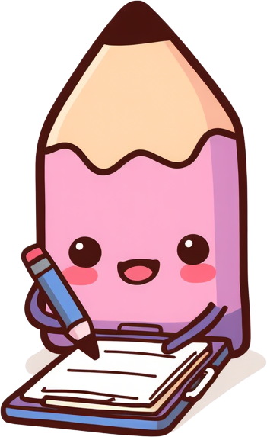
HOMEWORK ASSIGNMENT
This week, observe your child and write down what happens after their behaviors. Ask yourself: What happened immediately after? What did my child gain or avoid? Did the behavior increase or decrease over time? Remember, there are no wrong answers - we're just learning to notice patterns together!
19

Slide 26
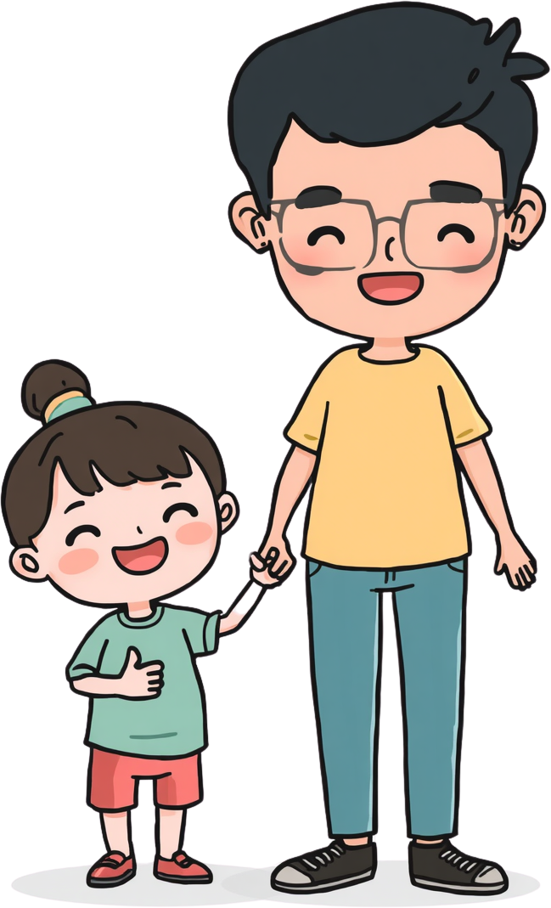
THANK
YOU!
In our next session, we will talk about replacement skills, functional communication skills, and behavior plans!

