Slide 1


UNDERSTANDING YOUR CHILD'S BEHAVIOR PLAN AND DATA
A Practical Guide for Parents

Slide 2

GOALS FOR TODAY
Understand what a Behavior Intervention Plan (BIP) includes and learn key behavior terms: antecedents, consequences, operational definitions, and replacement behaviors.
Learn to read common data graphs (line, bar, and column) and discover how to use behavior data at home while collaborating effectively with your care team.
2

Slide 3
WHAT IS A BEHAVIOR PLAN?
Clearly describes the target behavior and explains why it happens (the function) so everyone responds consistently.
1.
Outlines antecedent strategies (to prevent the behavior) and response strategies (what to do when it occurs).
2.
Identifies replacement behaviors to teach and tracks progress using data and graphs over time.
3.
3

Slide 4

WHY BEHAVIOR PLANS WORK
Behavior is learned and that means it can change. When adults respond consistently and teaching is intentional, children learn new, more effective ways to meet their needs. A well-designed plan makes those consistent responses easier for everyone.
Data is the roadmap. Tracking behavior over time shows whether the plan is working, when to adjust, and where to celebrate progress. When families and care teams share data and stay aligned, children make faster, more lasting gains.
4

Slide 5

KEY TERM REFRESHER:
ANTECEDENTS
An antecedent is what happens right before a behavior occurs. Recognizing antecedents helps us prevent challenging behaviors before they start.
• Stopping a preferred activity (e.g., turning off a video)
• A difficult or non-preferred task beginning
• Increased noise or sensory input
• Attention shifting away from your child
Tip: When we adjust antecedents, we reduce the chance the behavior will occur in the first place.
5

Slide 6

CONSEQUENCES
What happens right after a behavior is called a consequence and it shapes whether that behavior happens again.
• Adult attention (even a look or a word)
• Escape from a task or demand
• Access to a preferred item or activity
If a consequence is rewarding, the behavior is more likely to repeat. If it's not, the behavior may fade over time. Understanding consequences helps us respond in ways that support the right behaviors.
6

Slide 7

KEY TERM REFRESHER:
OPERATIONAL DEFINITIONS
An operational definition describes a behavior in clear, observable, and measurable terms — so everyone on the team (and at home) is tracking the same thing.
✅ Good example: "Hitting = closed or open hand making contact with another person's body with force"
❌ Poor examples: "Aggressive," "acting out," "having a meltdown"
Why it matters: Clear definitions mean more reliable data, better decisions, and consistent responses from everyone supporting your child.
7

Slide 8

REPLACEMENT BEHAVIORS
Replacement behaviors are positive, teachable skills that serve the same function as the problem behavior giving your child a better way to get what they need.
• Asking for a break instead of shutting down
• Saying "help please" instead of acting out
• Tapping a card to get attention instead of calling out
Tip: Reinforce the replacement behavior more than the problem behavior — practice during calm moments!
8

Slide 9
FUNCTIONS OF BEHAVIOR
To GET something: A behavior may happen because it results in attention from others, access to preferred items or activities, or sensory input that feels good or calming.
To ESCAPE something: A behavior may happen to get away from difficult tasks, demands, discomfort, or overwhelming situations. Strategies in the plan are matched to the function.
1

Slide 10
PREVENTION STRATEGIES
Adjust tasks to make them more manageable: break into shorter steps, use visual supports (picture schedules, checklists), and offer choices to increase engagement and reduce frustration.
Modify the environment to reduce triggers: lower noise levels, adjust seating arrangements, consider timing of demands, and ensure materials are accessible and appropriate.
Use pre-corrects and proactive breaks: give gentle reminders of expectations before challenging moments, and offer scheduled breaks before behavior escalates.
10

Slide 11
TEACHING STRATEGIES
Explicitly teach replacement behaviors during calm, low-demand times — not in the middle of a challenging moment. Use role-playing and practice to help your child learn what to do instead. Break skills into small, manageable steps so your child can experience early success.
Be generous with reinforcement whenever your child attempts the replacement behavior. Praise, tokens, brief breaks, or preferred activities all count. The more rewarding the replacement behavior feels, the more likely your child is to use it — even when things get hard.
11

Slide 12

RESPONSE STRATEGIES
Prioritize safety first. Stay calm and keep your response brief. Follow the plan consistently (e.g., minimize attention if the behavior is attention-seeking). Prompt or allow your child to use their replacement behavior when possible.
Once your child is calm, gently return to the task or planned activity. Consistency in how adults respond is key. The plan works best when everyone follows the same steps every time.
12

Slide 13
HOW DATA IS COLLECTED
What is tracked: frequency (how often), duration (how long), intensity, or percentage correct. Data is collected during sessions, routines, or across the full day — by staff, parents, or both.
Focus on trends, not single days. One tough day doesn't mean the plan isn't working. Look for patterns over days and weeks to see real progress and decide if adjustments are needed.
13

Slide 14
GRAPH TYPES YOU'LL SEE
Line graphs show trends over time — each point represents a measurement (e.g., number of tantrums per day), and connected points reveal whether behavior is improving, worsening, or staying the same.
Bar and column graphs compare amounts across categories or time periods (e.g., Morning, Afternoon, Evening). Taller bars or longer bars mean more of the behavior was measured in that period.
14

Slide 15
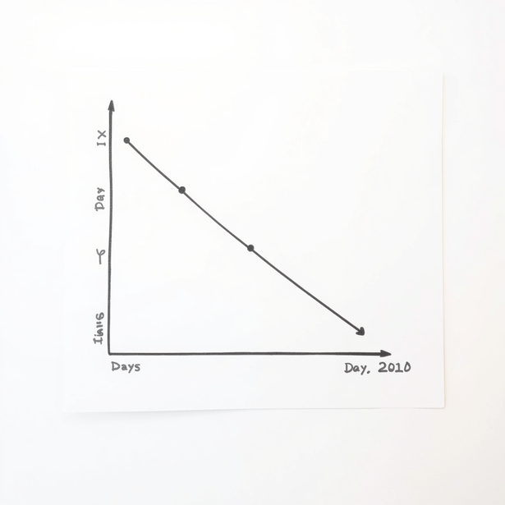
READING A LINE GRAPH
Title: tells you what is being measured (e.g., "Daily Number of Tantrums")
X-axis: shows time — days, weeks, or sessions across the bottom
Y-axis: shows the count or amount up the side
Points are connected left to right to reveal the pattern over time
15

Slide 16
LINE GRAPH: WHAT TO LOOK FOR
Trend direction: Is the line going down (improving), up (increasing), or staying flat? A downward trend for problem behavior is a good sign!
1.
Variability: Are the data points close together (consistent) or spread out (variable)? High variability may mean something in the environment is changing.
2.
Level shifts and phase markers: Look for vertical lines or labels on the graph — these mark when the plan changed. Did the pattern shift after that point?
3.
16

Slide 17

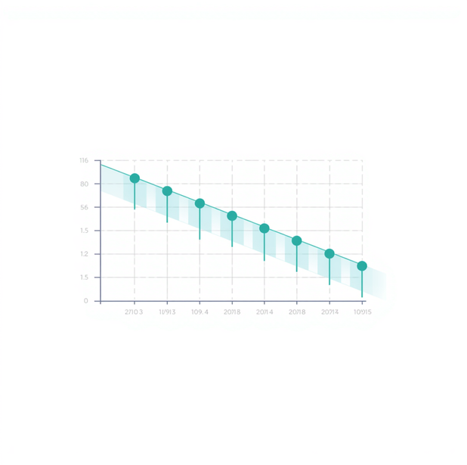
LINE GRAPH EXAMPLE: WALKTHROUGH
Weeks 1–2 (Baseline): 6–8 tantrums per day.
Week 3 (Intervention starts): drops to 3–4 per day.
Weeks 4–5: stable at about 2 per day — with one spike after a schedule change.
Takeaway: The overall trend is improving. Day-to-day ups and downs are normal — focus on the pattern, not each single day.
17

Slide 18
READING A BAR/COLUMN GRAPH
Bars represent amounts per category or time period. The X-axis shows categories (e.g., Morning, Afternoon, Evening) and the Y-axis shows the measurement (e.g., minutes on-task or number of behaviors).
Taller bars mean more of the behavior being measured. Always check the axis labels and scale so you can judge whether differences between bars are meaningful or small.
18

Slide 19
BAR VS. COLUMN GRAPHS
Bar graphs use horizontal bars to compare categories side by side — great when category labels are long or there are many items to compare. Both types show comparisons quickly at a glance.
Column graphs use vertical bars and are ideal for showing changes over time or across a few categories. Always check the scale on the Y-axis to judge whether differences are meaningful.
1

Slide 20
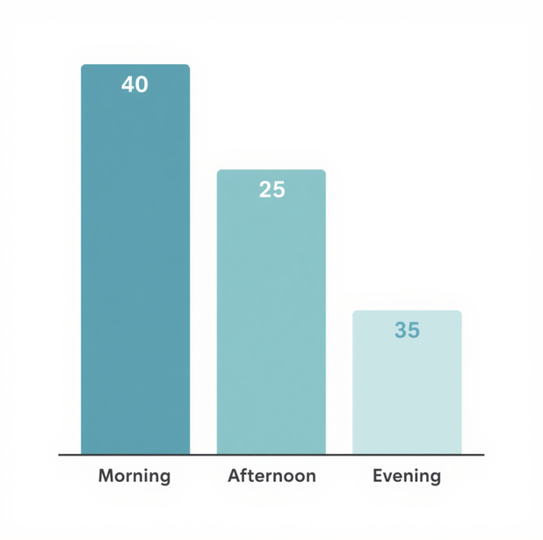
BAR/COLUMN GRAPH EXAMPLE
Morning on-task: 40 min
Afternoon on-task: 25 min
Evening on-task: 35 min
Afternoon is the lowest — consider offering a snack, a short break, or shorter tasks during this time. Look for the lowest bar to find where your child may need the most support.
20

Slide 21
PUTTING IT TOGETHER
Problem behavior increases during difficult tasks — the function is escape. When tasks feel too hard, behavior is the way out.
1.
The plan targets the function: offer more breaks, use easier task starts, and teach the phrase or signal for "help please."
2.
Reinforce the replacement! Praise or reward every "help please" request — more than the problem behavior ever earned.
3.
21

Slide 22
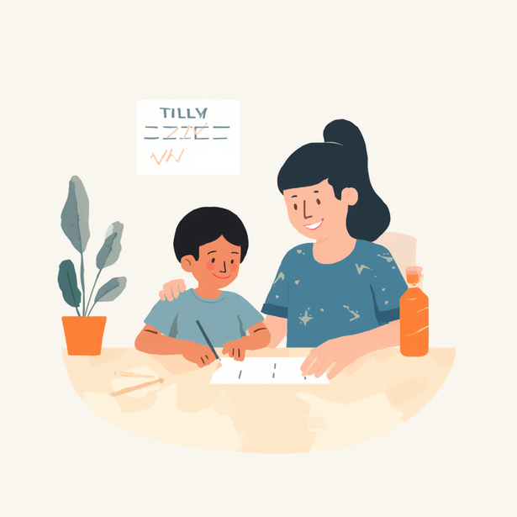
HOW TO USE GRAPHS AT HOME
Choose one problem behavior and one replacement skill to track. Use simple methods: tally marks, a timer, or stickers. Keep it easy so you can stay consistent every day.
Do a weekly review: look for trends — is the problem behavior going down? Is the replacement skill going up? Change only one thing at a time, and keep it in place for at least a week before adjusting.
22

Slide 23
COMMON PITFALLS AND FIXES
Inconsistent definitions can lead to unreliable data. Revisit and align on the operational definition with your team so everyone is measuring the same behavior the same way.
Accidentally reinforcing problem behavior happens easily. Shift your praise and attention to the replacement behavior instead — make sure the replacement "pays off" more than the problem behavior.
Changing too many things at once makes it hard to know what's working. Limit yourself to one change per week and give it time before adjusting again.
1

Slide 24
COLLABORATING WITH YOUR TEAM
Share home data and observations openly with your care team. Ask how your child's behavior function guides strategies used at school or in the clinic. Request that staff model prompts and reinforcement techniques so you can use them at home too.
Agree on 1–2 consistent steps that everyone — family, teachers, and therapists — will use the same way. Consistency across settings helps your child learn faster and makes the data more meaningful for everyone on the team.
24

Slide 25
QUESTIONS TO ASK ABOUT ANY GRAPH
What is being measured and how (count, duration, percent)? Over what time period was the data collected? What does the overall trend show — is it going up, down, or staying flat?
Were there any changes to the plan when the pattern shifted? Is the problem behavior going down while the replacement behavior goes up? Focus on trends over time, not just one or two days.
25

Slide 26

SAMPLE HOME DATA SHEET
A simple tracking form keeps data consistent and manageable. Use these columns each day:
📅 Date | # Behavior | Replacement Used? (Y/N) | Notes / Antecedents
Weekly review: circle your child's best day and note what helped. Keep it simple — a few tally marks beats a detailed log you can't maintain.
26

Slide 27

CELEBRATING PROGRESS
Every step forward counts — even small ones! Notice when your child seems calmer, asks for help more often, or uses their replacement behavior. Praise your child and every adult who sticks to the plan consistently. As skills grow, gradually raise expectations and goals. Progress is not always a straight line, but steady improvement over time is a real win worth celebrating.
27

Slide 28
WHEN TO REVISIT THE PLAN
No progress for 2–3 weeks, or behavior is getting worse despite consistent effort. New behaviors, life changes (new grade, schedule shift, or routine change), or increased safety concerns also signal it's time to review.
Schedule a team meeting to review the behavior's function, current strategies, and data trends. Bring your home observations — your input helps the team make better decisions together.
28

Slide 29



QUICK RECAP
Know your key terms: antecedents (what happens before), consequences (what happens after), operational definitions (clear, measurable descriptions), and replacement behaviors (positive skills serving the same function). Consistent use of these terms helps everyone on your team stay aligned.
Use graphs to spot patterns over time — not day-to-day swings. Teach and reinforce replacement behaviors consistently, collaborate openly with your care team, and adjust strategies based on what the data trends are showing you.
29

Slide 30















HOMEWORK
Let’s start collecting data at home.
Begin tracking one challenging behavior so we can better understand patterns and plan what works.
1
Choose one challenging behavior to track.
Pick the behavior that is most challenging right now.
2
Count each time it happens.
Every time the behavior occurs, add one count.
3
Record the date and brief notes.
Write the date and a short note about what happened before it.
Small data today,
big impact tomorrow.
4
Bring the data to our next team check-in.
Your data helps us spot patterns and celebrate progress together.
30

Slide 31
THANK YOU!
Questions? Handouts available: Key Term Cheat Sheet • Graph Reading Guide • Home Data Sheet Template
Tools: timer, tally counter, visual schedule apps
Contact us for follow-up coaching or questions — open floor now!

