Slide 1

REPLACEMENT
BEHAVIORS
TEACHING APPROPRIATE WAYS TO COMMUNICATE WANTS, NEEDS, AND EMOTIONS

Slide 2
01
Functional Communication Training
Today's Outline
02
Function-Based Replacement Behaviors
03
Prompting and Reinforcement
04
Approximations and Skill-Building

Slide 3

What Is a
REPLACEMENT BEHAVIOR?
A replacement behavior is a skill that serves the SAME function as the challenging behavior, but is safer and more appropriate.
It helps the individual get their needs met effectively through positive means.
Goal: Teach what TO do instead of only focusing on what NOT to do.
https://youtu.be/m3_vV9coy7Q?si=9socsrgz-Hk6h5bY

Slide 4
REAL-LIFE REPLACEMENT BEHAVIORS
Adults use replacement behaviors too.
Sometimes adults:
  Raise their voice
  Shut down
  Walk away
  Slam doors
  Avoid conversations
These behaviors often happen when:
  We are overwhelmed
  Frustrated
  Tired
  Feeling unheard
Healthy Adult Replacement Behaviors Might Include:
  Taking a deep breath
  Asking for a break
  Saying “I need a minute”
  Walking away calmly
  Using coping strategies
  Communicating frustration appropriately

Slide 5
WHY TEACHING REPLACEMENT BEHAVIORS CAN BE DIFFICULT
Important Reminder
Replacement skills:
  Take time
  Require repetition
  Need consistent reinforcement
  Must be practiced during calm moments first
Children with autism may experience challenges with:
  Communication
  Emotional regulation
  Flexibility
  Processing language
  Identifying emotions
  Tolerating frustration or waiting
During stress or overwhelm, challenging behavior may feel:
  Faster
  Easier
  More effective

Slide 6
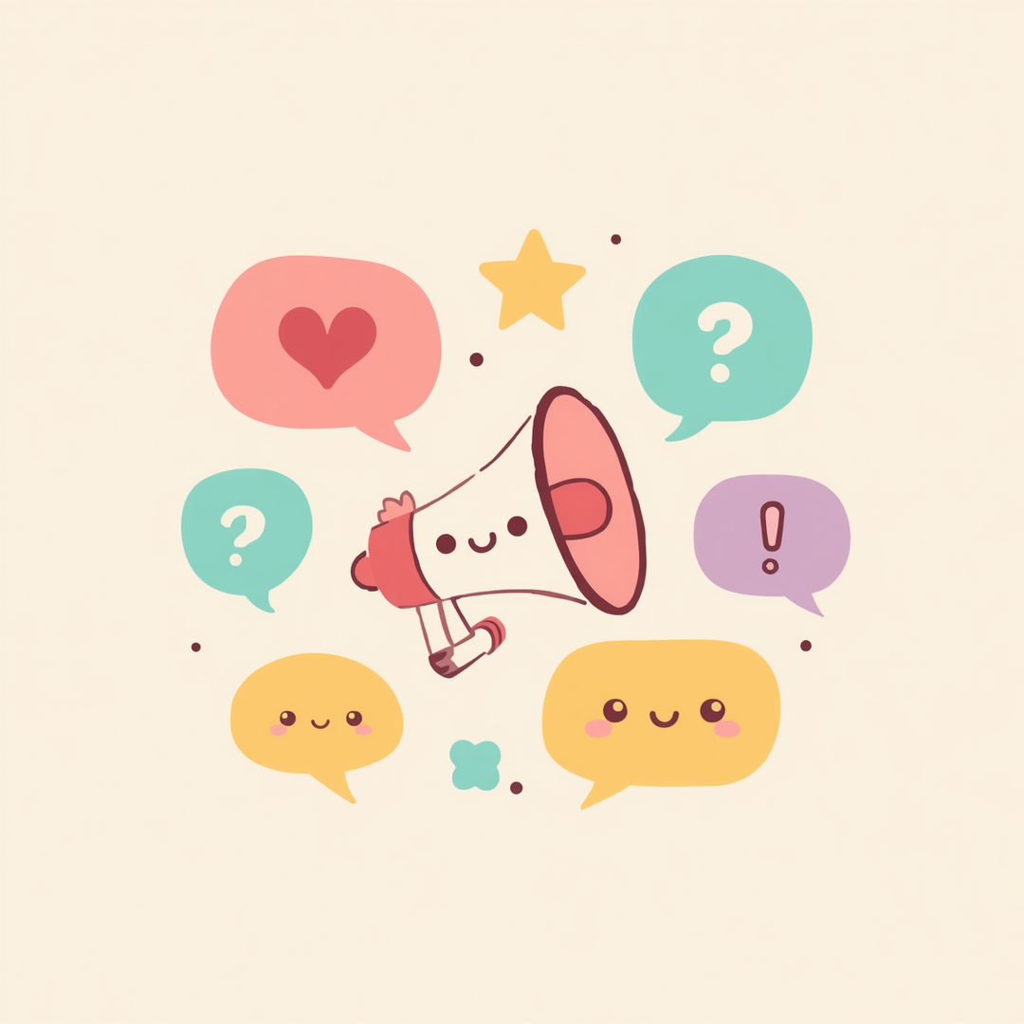
FUNCTIONAL COMMUNICATION TRAINING (FCT)
Functional Communication Training (FCT) teaches individuals to communicate their needs in appropriate ways. Instead of challenging behaviors like tantrums, aggression, refusal, or elopement, we can teach:
• Asking for help
• Requesting a break
• Asking for attention
• Requesting preferred items
When individuals have effective ways to communicate, frustration decreases and independence increases!

Slide 7
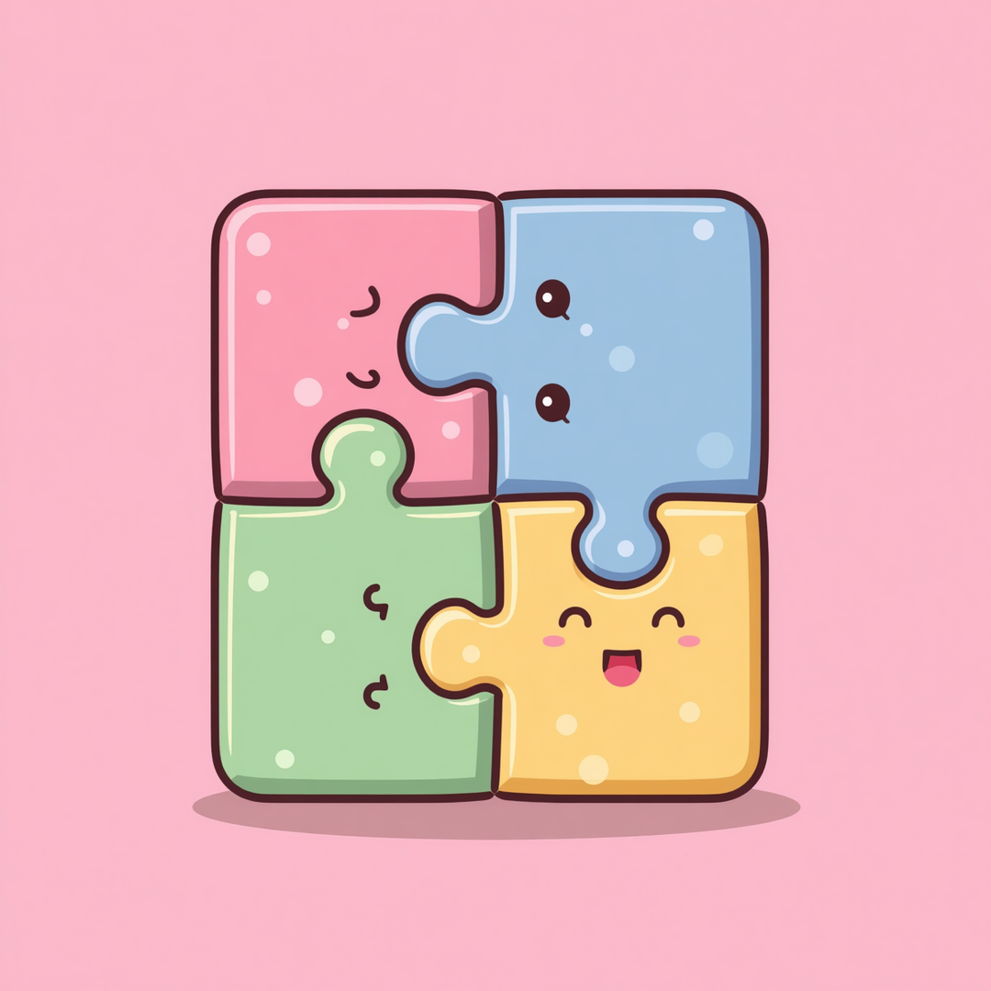
Replacement Behaviors Must
MATCH THE FUNCTION
Attention: Teach ways to gain attention appropriately
Escape: Teach requesting breaks or help appropriately
Tangible: Teach appropriate requesting and waiting
Sensory: Teach safe ways to meet sensory needs
Key Point: Replacement behavior must meet the SAME need
Matching function = effective communication
Wrong match = behavior continues or worsens

Slide 8



Examples of Replacement Behaviors
Attention: "Play with me", tapping appropriately, raising hand
Escape: "Break please", "Help", "All done"
Tangible: requesting items, waiting, asking for turns

Slide 9
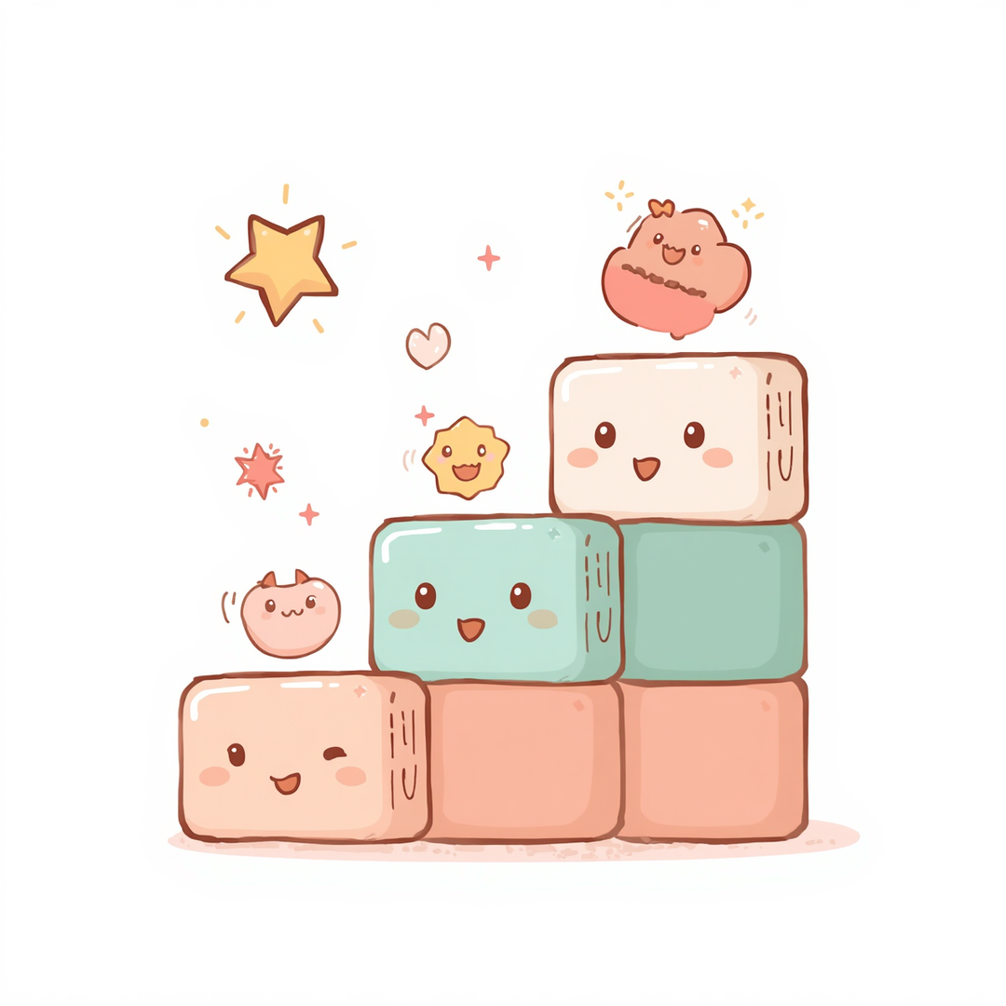
ACCEPTING APPROXIMATIONS
Teaching communication happens in small, gradual steps. Every attempt at communication is progress worth celebrating!
Example progression:
Sign for "more" → vocalization ("mmm") → "more" → "want more" → "I want more please"
Reinforce approximations immediately while gently shaping toward more complex skills over time. Meeting learners where they are builds confidence and momentum.

Slide 10
APPROXIMATION FOR WAITING
For many children with autism, waiting can feel extremely difficult because of challenges with:
  Delayed gratification
  Communication
  Emotional regulation
  Flexibility
  Understanding time
  Impulse control
Some children may think:
  “I want it NOW.”
  “I don’t know how long this will last.”
  “I don’t know what happens next.”
  “I don’t know how to handle this feeling.”
Waiting may feel:
  Confusing
  Anxiety-provoking
  Physically uncomfortable
  Overwhelming
Many children need waiting to be directly taught and practiced in small steps.
Strategies for Teaching Waiting
  Start with VERY short waiting periods
  Use visual timers or countdowns
  Give clear expectations
  Reinforce successful waiting
  Gradually increase wait time over time
  Pair waiting with preferred activities or supports
Example
Instead of expecting:
“Wait 10 minutes”
We may start with:
  Waiting 5 seconds
  Then 15 seconds
  Then 30 seconds
  Slowly building tolerance over time

Slide 11

TEACHING DURING CALM MOMENTS
The best time to teach replacement behaviors is when the individual is calm and regulated, not during a crisis.
Best practices for teaching replacement skills:
• Teach through practice and repetition during calm moments
• Introduce skills BEFORE challenging situations occur
• This allows for early prompting and prevention of escalation
• Teaching only during crises is much harder and less effective
• Regular practice builds confidence and automatic responses
• Create opportunities to rehearse skills in low-stress settings

Slide 12

Reinforcing
REPLACEMENT BEHAVIORS
Reinforce immediately after the behavior occurs
Respond consistently every time
Make communication effective and worthwhile
Give attention when appropriately requested
Provide breaks when asked for properly
Grant access to requested items
Offer praise and encouragement generously

Slide 13
7
Expecting skills without teaching them
Waiting until escalation to teach
Making replacement behaviors too difficult
Ignoring communication attempts
Inconsistent responses
Lack of repetition and practice
Forgetting consistency is key
COMMON MISTAKES

Slide 14
01
At Home
Generalization Matters
02
At School
03
In the Community
04
With Multiple People

Slide 15

Key Takeaways
REMEMBER THESE!
Replacement behaviors meet the same function as challenging behavior
FCT teaches appropriate communication skills
Communication looks different for every individual
Approximations are a normal part of learning
Teaching happens during calm moments, not just crises
Reinforcement promotes future use of replacement skills
Consistency and patience lead to lasting progress

Slide 16
Replacement Behavior Practice
Choose ONE replacement behavior to practice:
• Asking for help • Requesting a break
• Asking for attention • Waiting appropriately
Practice during calm moments and reinforce immediately when used.
Reflection Questions:
• Was the replacement behavior easier to use?
• Did escalation decrease?
• What reinforcement worked best?
Homework
Assignment

Slide 17

Questions &
DISCUSSION
Which replacement behaviors may help most at home?
What communication challenges are most common?
What situations are hardest for communication?

