Slide 1


Understanding Behavior Plans:
MEDICAID UPDATES & ABA FUNDAMENTALS
=

Slide 2
Series List
Presentation 6: Prompting and Skill Acquisition
An overview of prompting strategies, prompt fading, shaping, chaining, and how new skills are systematically taught and maintained.
Presentation 7: Extinction and Behavior Reduction Procedures
A review of behavior reduction procedures, extinction, extinction bursts, response strategies, and maintaining consistency during challenging behaviors.
Presentation 8: Generalization and Maintenance
Understanding how skills transfer across people, settings, and environments while promoting long-term maintenance of learned skills.
Presentation 9: Understanding the Full Behavior Plan
Putting all components together by reviewing how behavior plans are written, implemented, monitored, and updated collaboratively across caregivers and providers.
Presentation 1: Behaviors and Their Functions: Overview
An introduction to behavior, including operational definitions, the four functions of behavior, and setting events that may impact behavior.
Presentation 2: Consequences to Behaviors: Overview
An overview of consequences and how they influence future behavior through reinforcement and punishment procedures.
Presentation 3: Antecedents and Their Strategies
A deeper look into what happens before behaviors occur, including triggers, precursor behaviors, environmental variables, and proactive prevention strategies.
Presentation 4: Replacement Behaviors
Understanding how replacement behaviors are selected and taught to help individuals appropriately communicate wants, needs, and emotions.
Presentation 5: Reinforcement Systems
Exploring reinforcement systems used within behavior plans, including token systems, differential reinforcement, motivation, and behavior-specific praise.

Slide 3

MEDICAID PARENT TRAINING REQUIREMENT
Medicaid now requires 2 hours of parent training every month (12 hours every 6 months). This is important! If you don't meet this requirement, your child's services may be denied authorization. Let's work together to stay on track!

Slide 4

COMPREHENSIVE VS FOCUSED CARE
Comprehensive Care: 17+ hours/week
Focused Care: 16 or fewer hours/week
Lifetime Allowance: 4,000 hours of comprehensive care. After reaching this limit, services may switch to focused care if medically necessary.
Remember: Authorized hours count toward your lifetime limit, even if not attended!

Slide 5

MANAGING LIFETIME HOURS AND ATTENDANCE
Attendance matters! If your client attends fewer hours than authorized, those hours still count toward the 4,000 lifetime limit. Strategy: adjust weekly hours to match actual attendance and avoid wasting precious authorized time. Goal: minimize lifetime hours used while maximizing therapy effectiveness!

Slide 6

PARENT TRAINING SERIES OVERVIEW
This series builds your ABA knowledge step by step! Today we'll cover: the four functions of behavior, ABC data collection, functional assessments, and behavior consequences. Future sessions will expand on these foundations!

Slide 7

WHAT IS AN OPERATIONAL DEFINITION?
An operational definition is a clear, objective, and measurable description of a behavior. It ensures everyone on the team identifies and understands the behavior the same way!
Example: "Hitting" = closed fist contact to another person's body

Slide 8

THE FOUR FUNCTIONS OF BEHAVIOR
  Attention: Behavior to gain social attention from others
  Escape: Behavior to avoid or get out of something unpleasant
  Access to Tangibles: Behavior to obtain a preferred item or activity
  Sensory/Automatic: Behavior that provides internal sensory stimulation

Slide 9

THE FOUR FUNCTIONS OF BEHAVIOR Video
  The 4 Functions of Behavior Explained | A Parent & Caregiver Guide

Slide 10

UNDERSTANDING ANTECEDENTS: ABC DATA COLLECTION
A = Antecedent: What happens before the behavior
B = Behavior: The observable action we see
C = Consequence: What happens after the behavior
Collecting ABC data helps us identify why behaviors occur!
ABC Data Collection Explained | A Parent & Caregiver Guide

Slide 11

PRACTICE SCENARIO: TAKING ABC DATA
Mom tells 7-year-old Jackson that it is time to turn off the iPad and begin homework. Jackson says, “No, I’m not doing homework!” and throws the iPad onto the couch. He then begins crying loudly and runs to his bedroom. Mom follows him to the room and tells him he can take a 10-minute break before starting homework.
Discussion Questions
  What happened immediately before the behavior?
  Was the behavior observable and measurable?
  What happened immediately after the behavior?
  What might the child have been trying to gain or avoid?

Slide 12

PRACTICE SCENARIO: TAKING ABC DATA
Over the past several weeks, whenever Mom talks on the phone, 6-year-old Ava begins pulling items off the coffee table and throwing them onto the floor. During today’s phone call, Ava again throws magazines and remote controls onto the ground while looking toward Mom. Mom immediately tells Ava to stop, takes the items away, and ends her phone call to talk to Ava about her behavior.
Discussion Questions
  What pattern do you notice in this scenario?
  What happened immediately before the behavior?
  What specific behaviors should be recorded?
  What happened immediately after the behavior?
  How might attention be maintaining this behavior over time?

Slide 13

PRACTICE SCENARIO: TAKING ABC DATA
Dad tells 5-year-old Liam it is time to clean up his toys and come to the dinner table. Liam, who communicates nonvocally, drops to the floor, kicks his legs, and pushes the toy bin away when Dad hands it to him. Dad picks up the toys himself and allows Liam to stay in the living room for a few more minutes before dinner.
Discussion Questions
  What happened immediately before the behavior?
  Which behaviors were observable and measurable?
  What happened immediately after the behavior?
  Did the consequence possibly help Liam avoid or delay the task?

Slide 14

FUNCTIONAL ASSESSMENTS: QABF AND FAST
QABF (Questions About Behavioral Function): A questionnaire that helps identify why a behavior occurs by asking about different situations.
FAST (Functional Assessment Screening Tool): Another helpful tool that screens for behavior functions. Both assessments guide our team in creating the best intervention plan for your child!

Slide 15
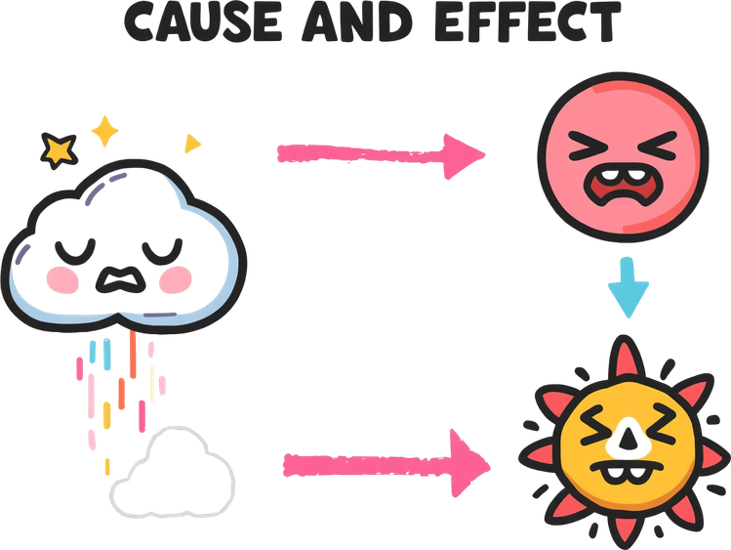
SETTING EVENTS & PRECURSOR BEHAVIORS
Setting events are bigger picture factors that affect behavior like changes in medication, poor sleep, or loud environments.
Precursor behaviors are small warning signs that happen before a bigger behavior occurs.
Examples of precursor behaviors may include pacing, whining or crying, increased vocal volume, repetitive questioning, refusing simple demands, turning away from staff, crossing arms, foot stomping, sighing or huffing, and facial grimacing.
Understanding both helps us see the full story of why behaviors happen!
10

Slide 16
PRACTICE SCENARIO: IDENTIFYING SETTING EVENTS
Eight-year-old Mason usually tolerates homework with minimal difficulty. However, today Mason only slept for a few hours overnight because he was sick. After school, his mom asked him to complete a math worksheet. Mason immediately began yelling, pushing materials off the table, and crying.
Discussion Questions
  What happened earlier that may have affected Mason’s behavior later?
  Did the setting event happen immediately before the behavior?
  How might lack of sleep change how someone responds to demands?
  Why is it important to consider setting events when reviewing behavior patterns?

Slide 17
PRACTICE SCENARIO: IDENTIFYING SETTING EVENTS
Scenario
Nine-year-old Olivia typically transitions into school without difficulty. This morning, Olivia’s parent reported that she missed her regular medication before leaving for school. Later that day, when her teacher asked the class to put away tablets and begin independent work, Olivia screamed, pushed her chair back, and tore up her worksheet.
Discussion Questions
  What happened earlier in the day that may have influenced Olivia’s behavior?
  Did the missed medication directly cause the behavior?
  What was the immediate antecedent to the behavior?
  Why is it important to document setting events separately from antecedents?

Slide 18
PRACTICE SCENARIO:
IDENTIFYING PRECURSOR BEHAVIORS
Scenario
During math homework, 10-year-old Ethan begins sighing loudly, crossing his arms, and repeatedly saying, “This is too hard.” A few minutes later, when his dad prompts him to continue working, Ethan yells, throws his pencil across the room, and leaves the table.
Discussion Questions
  Which behaviors occurred before the major behavior escalation?
  Why might it be important to intervene during precursor behaviors?
  Which behaviors were observable and measurable?
  What strategies could be used when precursor behaviors first appear?
10

Slide 19
PRACTICE SCENARIO:
IDENTIFYING PRECURSOR BEHAVIORS
Scenario
Two-year-old Noah, who communicates nonvocally, is playing with blocks when his caregiver begins cleaning up toys and signals that it is almost time for bed. Noah starts whining, pushes the blocks away, avoids looking at the caregiver, and stomps his feet. When the caregiver attempts to guide him toward the bathroom, Noah drops to the floor crying and begins kicking.
Discussion Questions
  Which behaviors happened before the larger behavior escalation?
  Which behaviors might signal that Noah is becoming upset?
  Why is it helpful to recognize precursor behaviors early?
  What proactive strategies could be used when precursor behaviors first begin?

Slide 20
DETERMINING BEHAVIOR FUNCTION FROM DATA
To accurately identify behavior function, combine multiple data sources: ABC data, QABF results, and FAST assessments. Match behaviors to functions by looking for patterns. For example, if tantrums consistently occur when demands are placed and stop when tasks are removed, the function is likely escape. We work together as a team of parents, BCBAs, and RBTs to make decisions!

Slide 21

CONSEQUENCES & BEHAVIOR REDUCTION
Once we know WHY a behavior happens, we can choose the right consequence to help reduce it! There are three main types: Reinforcement (rewarding good behaviors), Extinction (not reinforcing problem behaviors), and Punishment (adding consequences). Consistency is key!
In our next meeting, we will go over consequences!

Slide 22

HOMEWORK
Before our next meeting, you will fill out the QABF or the FAST assessment for your child! Bring it back to our next meeting for us to go over together!

Slide 23

THANK
YOU!

